Slide 1


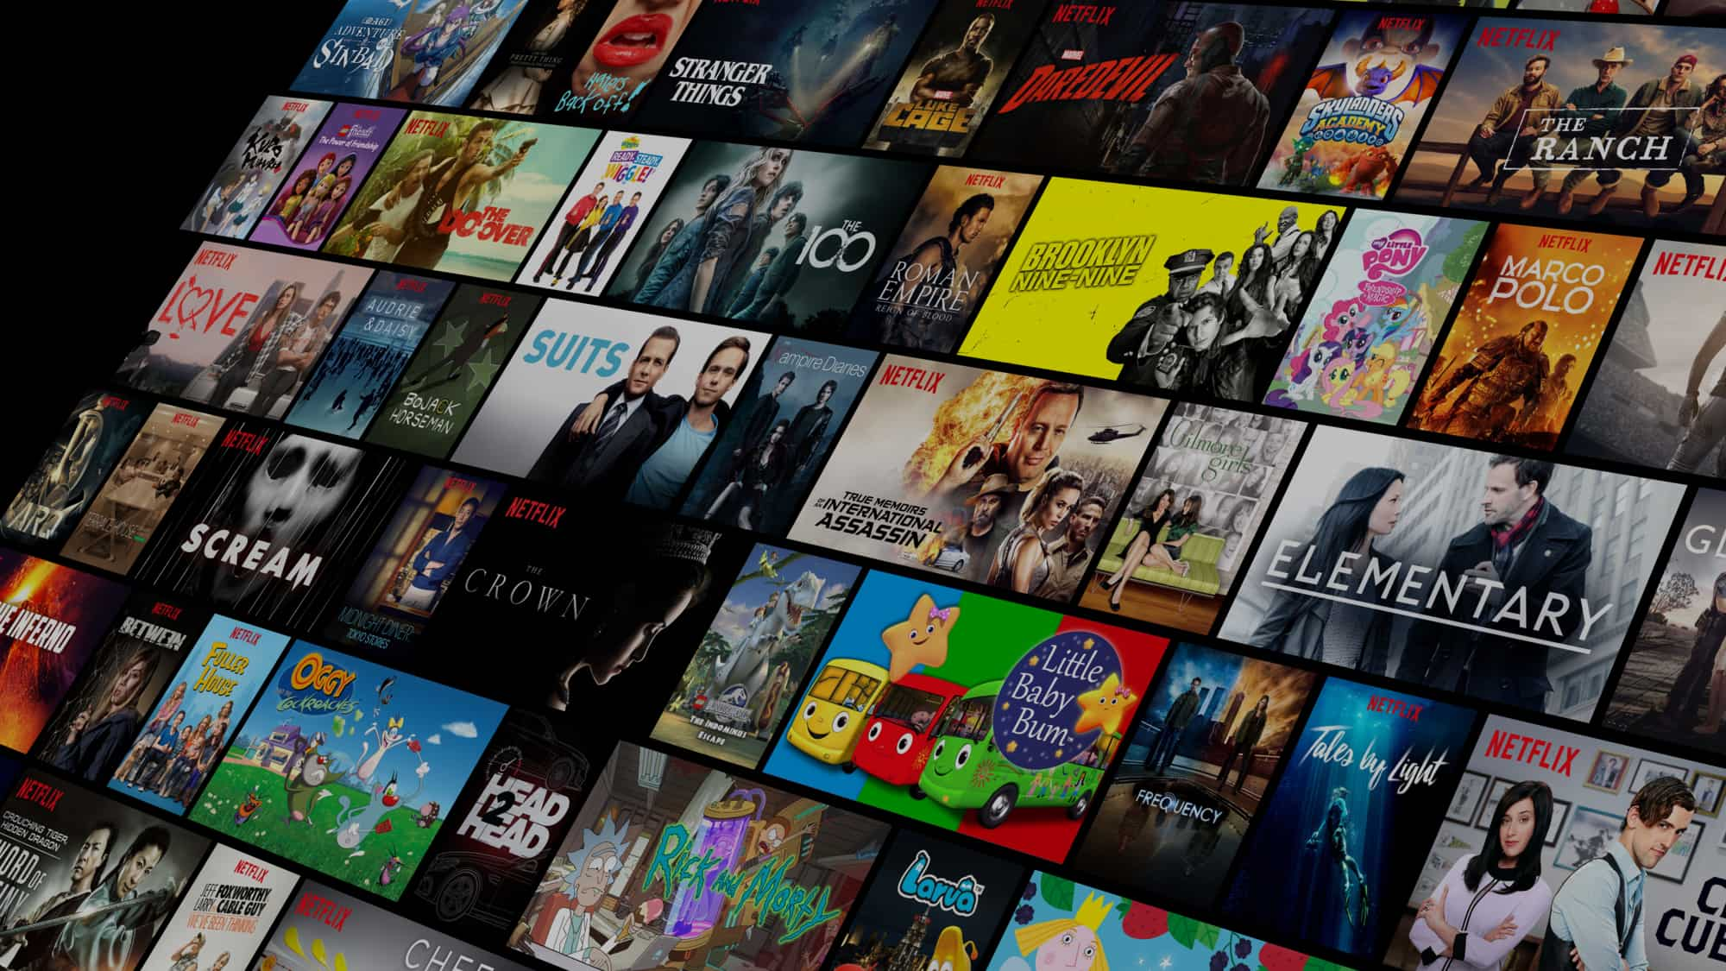

NETFLIX ANALYSIS
This Photo by Unknown Author is licensed under CC BY-SA
Project By:
Vansh Bhardwaj

Slide 2

NETFLIX
Netflix is an online streaming entertainment platform founded in the United States in 1997.
Netflix’s streaming service serves millions of customers across the globe, including India.
Customers can watch movies, TV shows, documentaries, and original series anytime, anywhere, through the Netflix app or website on their devices.

Slide 3
OBJECTIVES
To extract data from one of the leading online streaming entertainment platforms, Netflix.
To analyze data across various aspects like genre-wise content details, user viewing patterns, subscription pricing, and content ratings.
To extract meaningful insights that can help identify trends and build future strategies for new players to enter the streaming market.
To process and organize the data in a way that it can be scaled for real-time analysis, enabling more accurate recommendations and predictions.

Slide 4


Slide 5
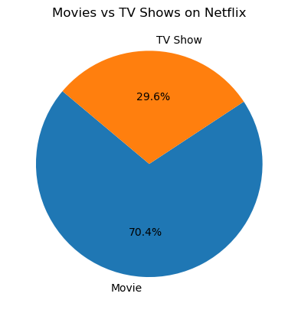
1) Movies vs TV Shows on Netflix
TV SHOWS:-29.6%(2577 peoples)
Movies:-70.4%(6129 peoples)

Slide 6
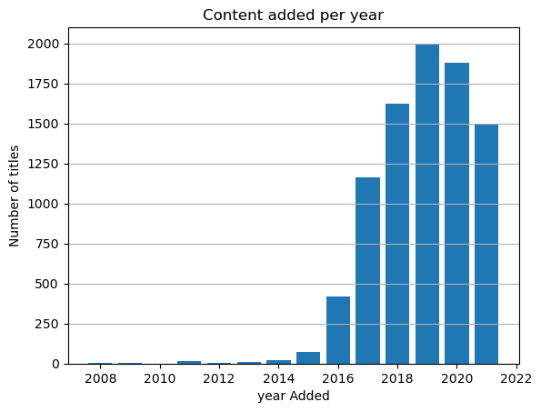

2)Content added per year on Netflix
2008: 2
2009: 2
2010: 1
2011: 13
2012: 3
2013: 10
2014: 23
2015: 73
2016: 416
2017: 1163
2018: 1625
2019: 1999
2020: 1878
2021: 1498

Slide 7
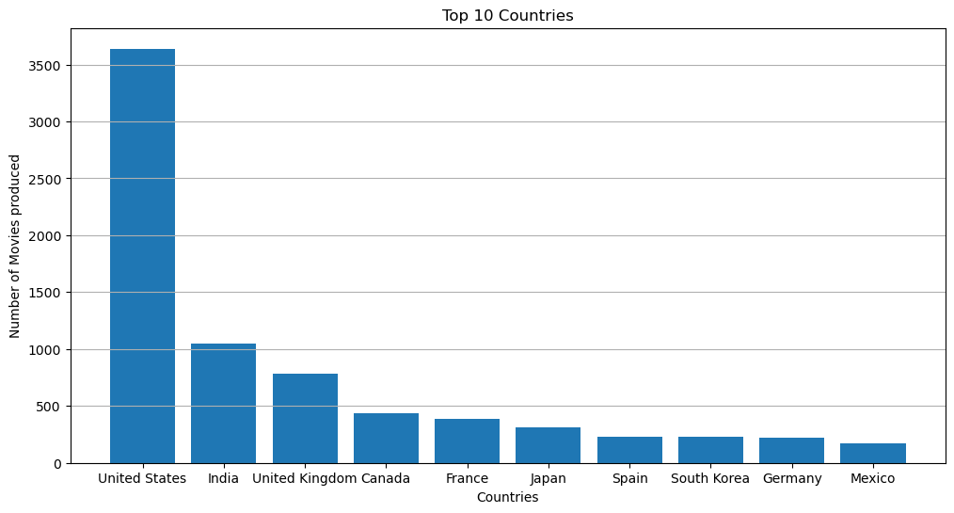
Top 10 Countries in Producing Movies
United States: 3,639
India: 1,045
United Kingdom: 785
Canada: 432
France: 389
Japan: 314
Spain: 228
South Korea: 226
Germany: 225
Mexico: 169

Slide 8
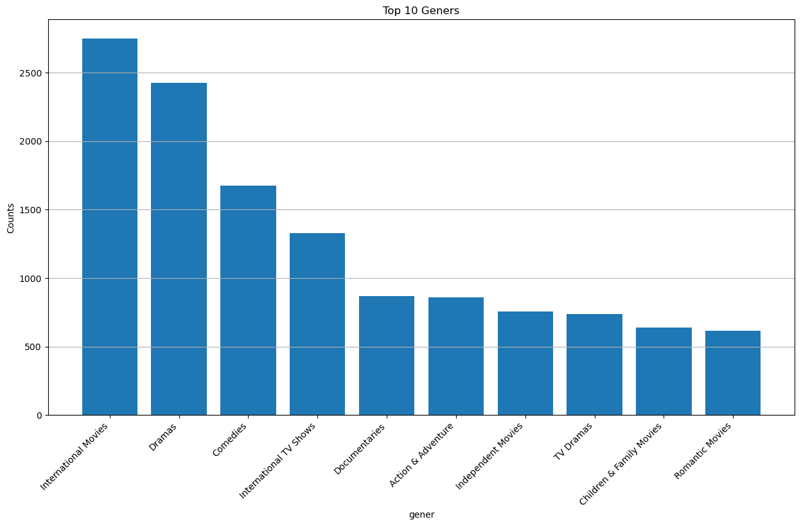
4) Top 10 Genres
International Movies: 2,752
Dramas: 2,427
Comedies: 1,674
International TV Shows: 1,328
Documentaries: 869
Action & Adventure: 859
Independent Movies: 756
TV Dramas: 739
Children & Family Movies: 641
Romantic Movies: 616

Slide 9
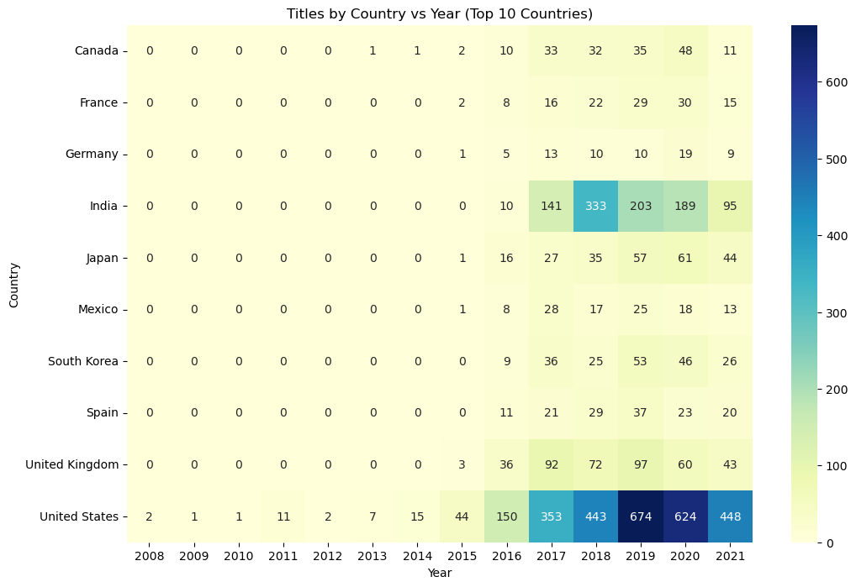
5) Titles by Country vs Year
Shows Netflix titles by year for top 10 countries.
US leads with highest content growth.
India shows rapid rise after 2017.
Japan, South Korea, UK also growing steadily.
Highlights Netflix’s global expansion focus.

Slide 10
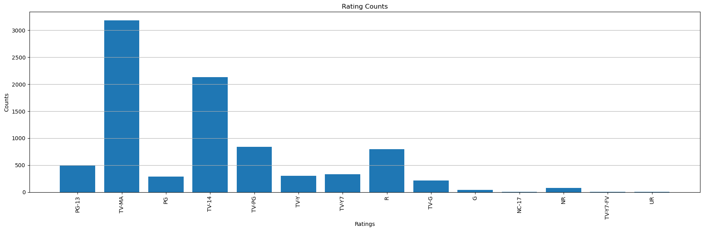
6) Rating Distribution
TV-MA: 3,183
TV-14: 2,133
TV-PG: 838
R: 799
PG-13: 490
TV-Y7: 330
TV-Y: 300
PG: 287
TV-G: 212
NR: 78
G: 41
TV-Y7-FV: 5
NC-17: 3
UR: 3

Slide 11
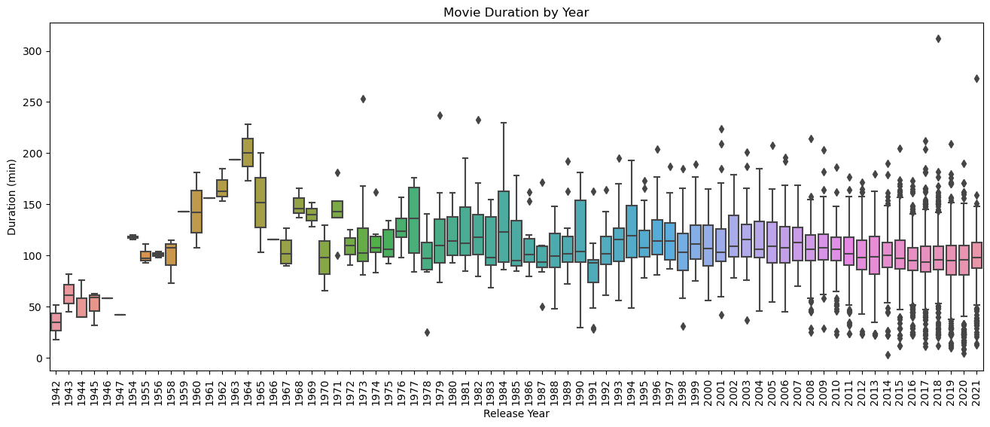
7) Movie Duration by Year
Shows movie duration trends by year.
Older movies were shorter; 1960s–80s had longer runtimes.
Recent movies average around 90–120 mins.
Outliers show some very long films.
Reflects changing audience and streaming trends.

Slide 12
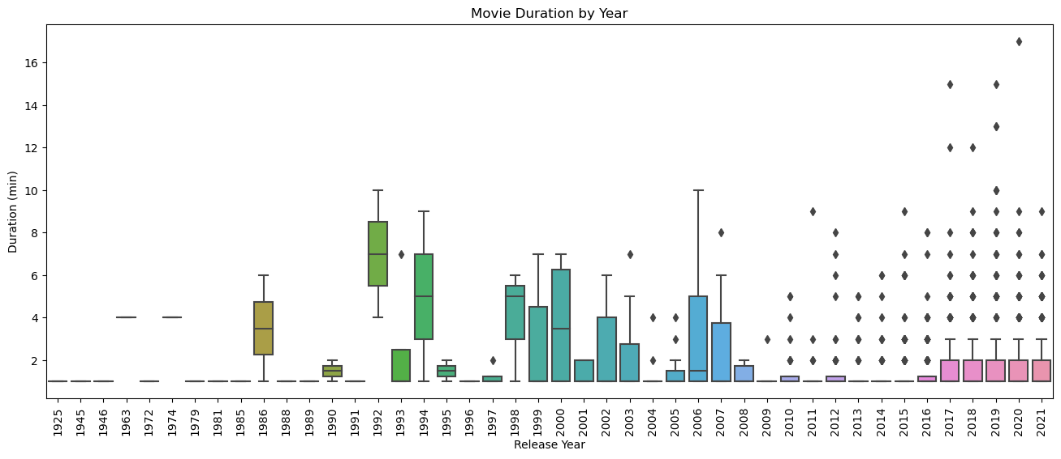
8) Tv show Duration by Year
Shows duration trends for very short Netflix content by release year.
Most short titles are under 5 minutes.
More short content appears in recent years.
Outliers show some slightly longer clips.
Indicates Netflix’s push for bite-sized content too.

Slide 13
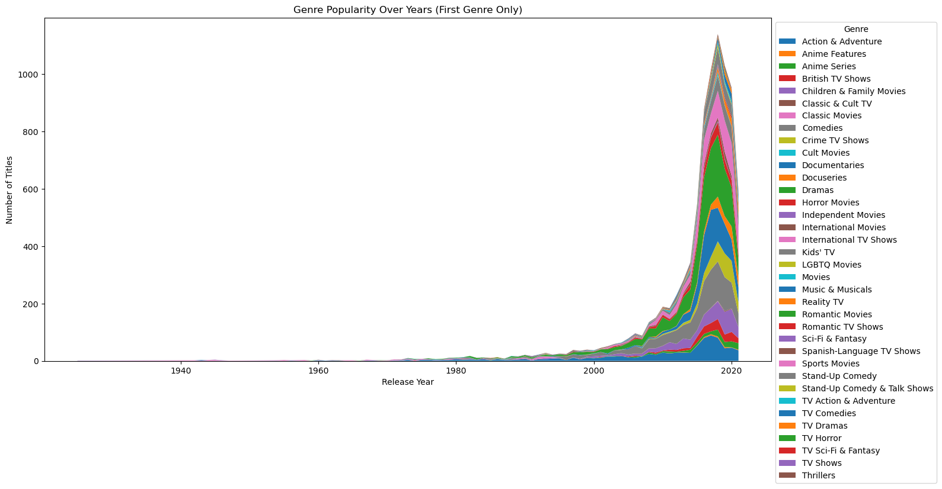
9) Genre Popularity Over Years
Shows how different genres have grown over time on Netflix.
Sharp rise in overall content after 2000.
Dramas, comedies, and international movies lead the trend.
Many genres show steady growth together.
Highlights Netflix’s expanding variety to reach wider audiences

Slide 14
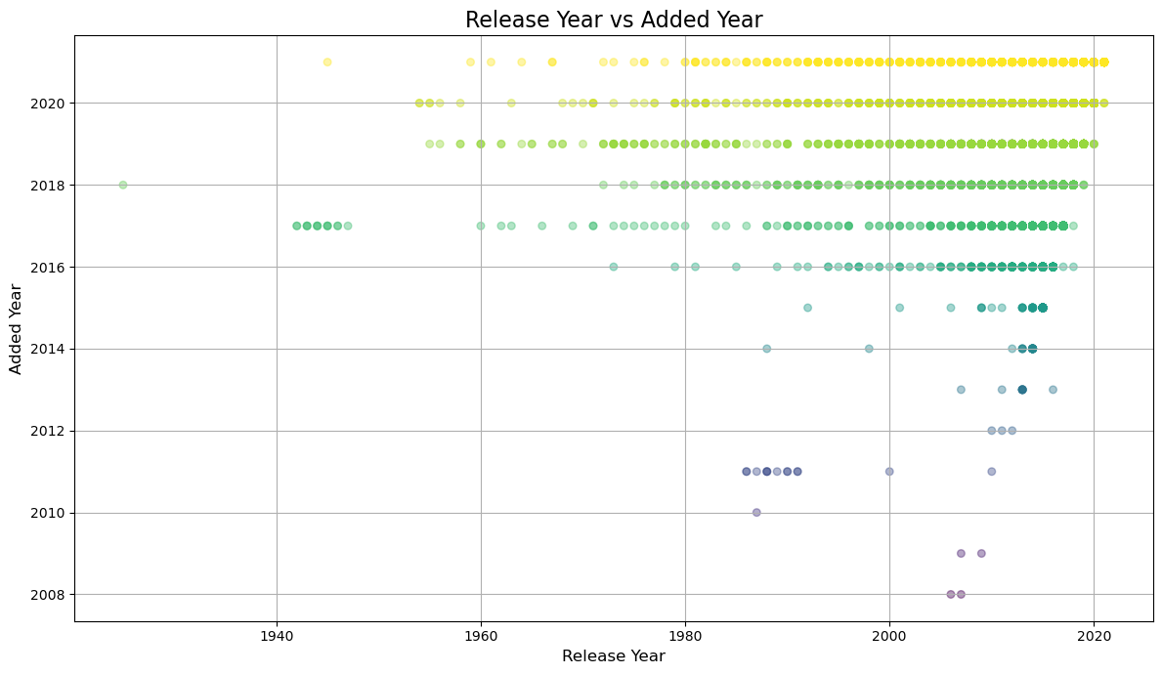
10) Release Year vs Added Year
Shows when Netflix titles were released vs when they were added to the platform.
Many old titles (1940s–2000s) were added recently.
Recent releases are added quickly after release year.
Clustering at the top shows Netflix expands its library every year.
Highlights Netflix’s mix of classic and new content.

Slide 15

Challenges
Data Availability and Quality
Genre and Category Overlaps
Dynamic and Evolving Content
Handling Large Datasets

Slide 16

Learning Outcomes
Improved Data Cleaning and Preprocessing Skills
Better Understanding of Visualization Technique
Ability to Extract Actionable Insights
Hands on experience with Real-World Datasets

Slide 17

This Photo by Unknown Author is licensed under CC BY-SA

